Slide 1

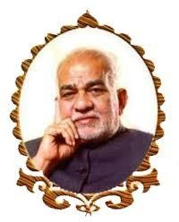
BVRIT HYDERABAD College of Engineering for Women Department of Computer Science and Engineering Review - 4
REAL TIME DROWSINESS DETECTION AND ALERT SYSTEM 03-05-2023
Under the Guidance of:
Name: Mrs. K Hema
Designation: Assistant Professor
Team No: 20
Names with roll numbers:
M. Suprathika : 19WH1A05F7
N. Sindhuja : 19WH1A05E6
R. Akanksha : 19WH1A05C5

Slide 2
AGENDA
Introduction
Existing system
Problem statement
Literature Survey
Proposed system
Flowchart
Tools and Technology
Societal impact
Project timeline
References

Slide 3
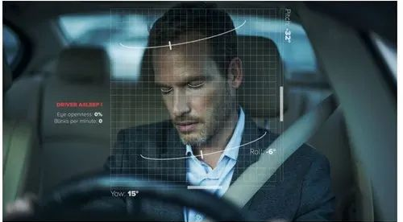
INTRODUCTION
A lot of accidents are caused due to drowsy driving every year and it often goes undetected thereby leading to huge loss of lives and resources.
A variety of studies have recommended that around 20% of all road accidents are due to drowsiness of the driver.

Slide 4
EXISTING SYSTEM
Some machine learning approaches including support vector machines, convolutional neural networks, in the context of, drowsiness detection.
In the field of sleepiness detection, hidden Markov models and neural networks are used. Additionally, a meta-analysis of 25 studies using machine learning algorithms for sleepiness detection is done.

Slide 5
PROBLEM STATEMENT
To prevent traffic accidents, it is necessary to design a model that can recognize driver fatigue and alert them at time of accidents.
In order to effectively identify a driver's state utilising a novel technique that makes use of the spatiotemporal aspects of the face, a deep learning-based model is then developed that detects drowsiness from various facial gestures, while driving , records and alerts the driver for the same.

Slide 6
LITERATURE SURVEY
S.No | Title of the paper | Author(s) & Journal Details | Description/ Interpretation
1 | Driver Drowsiness Detection using Machine Learning Approach | Authors: Priyanka Basavaraj Murdeshwar, Shruthi Tharanath, Surekha Reddy, Manjunath, Journal: Journal of Engineering Research and Applications | approach has three stages: detecting Face – Haar Cascade, detecting Eyes - Adaboost( selecting important features) and detecting drowsiness –based on EAR.
2 | Real-time Driver Drowsiness Detection for Android Application Using Deep Neural Networks Techniques | Authors: Rateb Jabbar , Khalifa Al-Khalifa, Mohamed Kharbeche, Wael Alhajyaseen, Mohsen Jafari , Shan Jiang 9th International Conference on Ambient Systems, Networks, and Technologies | The landmark coordination extracted from images will act as the input to the Multilayer Perceptron Classifier . The training will be processed till the accuracy is reached. Accuracy – 80.92%
3 | Driver drowsiness detection using Behavioral measures and machine learning techniques: A review of state-of-art techniques | Authors: Mkhuseli Ngxande, Jules-Raymond Tapamo, Michael Burke Pattern Recognition Association of South Africa and Robotics and Mechatronics | Machine learning techniques such as SVM, CNN, and HMM are reviewed on image yawn eye dataset. CNNs yielded more accurate results when compared to SVMs and HMMs.

Slide 7
LITERATURE SURVEY (cont..)
S.No | Title of the paper | Author(s) | Description/ Interpretation
4 | Real-Time Driver Drowsiness Detection System Using Eye Aspect Ratio and Eye Closure Ratio | Sukrit Mehta, Sharad Dadhich, Sahil Gumber, Arpita Jadhav Bhatt | Developed using Haar classifier and Dlib by calculating EAR and ECR
5 | An Investigation of Early Detection of Driver Drowsiness Using Ensemble Machine Learning Based on Hybrid Sensing | Jongseong Gwak, Akinari Hirao, and Motoki Shino | Features of drowsiness detection by cameras are divided into handcrafted features, or features learned automatically using CNNs An accuracy of 65.2% was evaluated on pretended data
6 | Driver Drowsiness Detection System for Vehicle Safety | A. Subbarao, K.Sahithya International Journal of Innovative Technology and Exploring Engineering | the eye blink of the driver is detected by using eye blink sensor which is IR based. The disparity across the eye will vary as per eye blink.The output is high, if the eye is closed or else output is low

Slide 8
PROPOSED SYSTEM
In this project, two models are being developed, and they are as follows:
Base Model - This is a generic model for sleepiness detection that was created and trained from scratch using the dataset. There is no idea of transfer learning.
Inception V3
Final Model - We are building a model in such a way that initial layers are that of the VGG-16 Model(fine tuning approach), pre-trained on imagenet weights.
We are going to use real time NTHU dataset as used by many other models mentioned in our base-paper, as a training dataset.

Slide 9
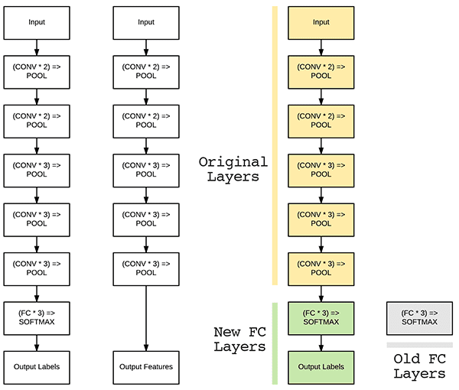
ARCHITECTURE

Slide 10
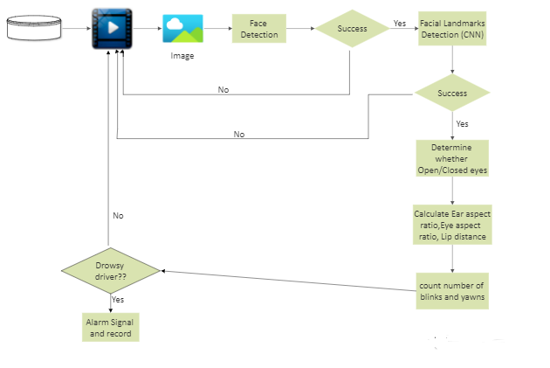
FLOW CHART
Frame

Slide 11
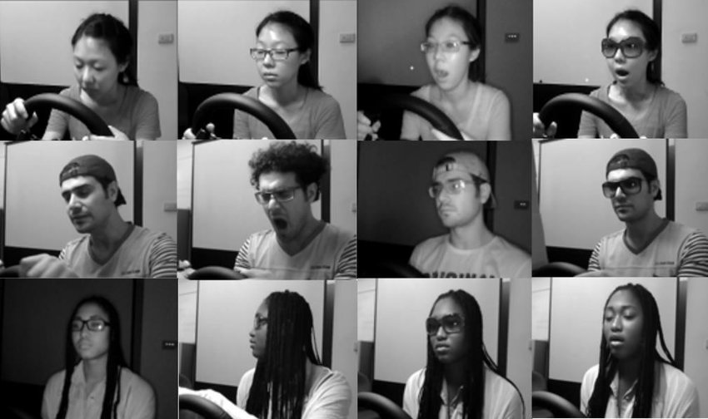
DATASETS
IMAGE DATASET :
Yawn Eye Dataset for Drowsiness Detection
VIDEO DATASET :
National Tsing Hua University (NTHU) Driver Drowsiness Detection Dataset

Slide 12
TOOLS AND TECHNOLOGIES
Keras
TensorFlow
Dlib
CNN
WinSound Module
OpenCV

Slide 13
SOCIETAL IMPACT
One of the major causes behind the casualties of people in road accidents is driver’s drowsiness.
According to the report by “Ministry of Road Transport & Highways” there were 4,552 accidents reported every year in India, that took lives of thousands of people because of sleepy drivers.
Using this model, we can not only stop the occurance of accidents, but also can save lives and resources.
It is cost effective as we don’t require any hardware sensors and the detection is done through webcam. So all the communities can easily afford it.

Slide 14
PROJECT TIMELINE
Date | Review | Task
23-09-2022 | Review 0 | Introduction/ abstract Specifications References
17-11-2022 | Review I | Image, Video dataset processing and flow of the project
24-12-2022 | Review II | Creating model and detecting facial landmarks. Examine the face, mouth, and eyes for signs of drowsiness.

Slide 15
PROJECT TIMELINE
Date | Review | Task
25-03-2023 | Review III | Implementation of Baseline model and final model Developed drowsiness detection using eyes without threshold count
03-05-2023 | Review IV | Implemented the baseline model and final VGG16 fine tuning approach model and the detection system by adding threshold count.

Slide 16
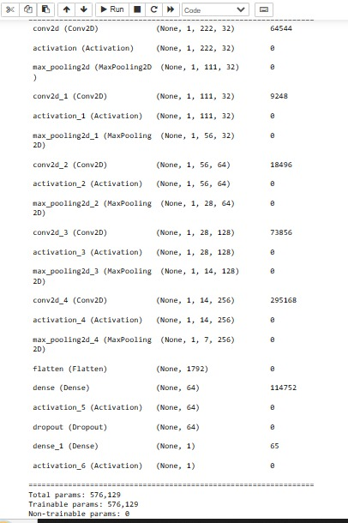
OUTPUT
ARCHITECTURE OF THE BASELINE MODEL

Slide 17
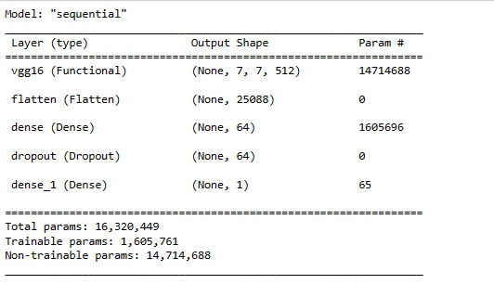
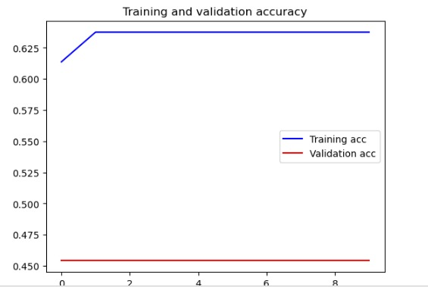
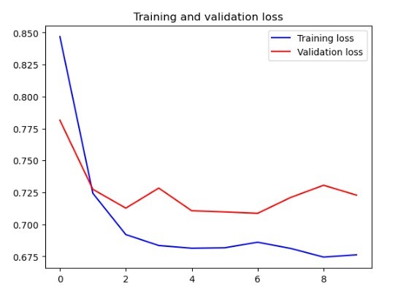
OUTPUT
ARCHITECTURE OF THE FINAL MODEL

Slide 18
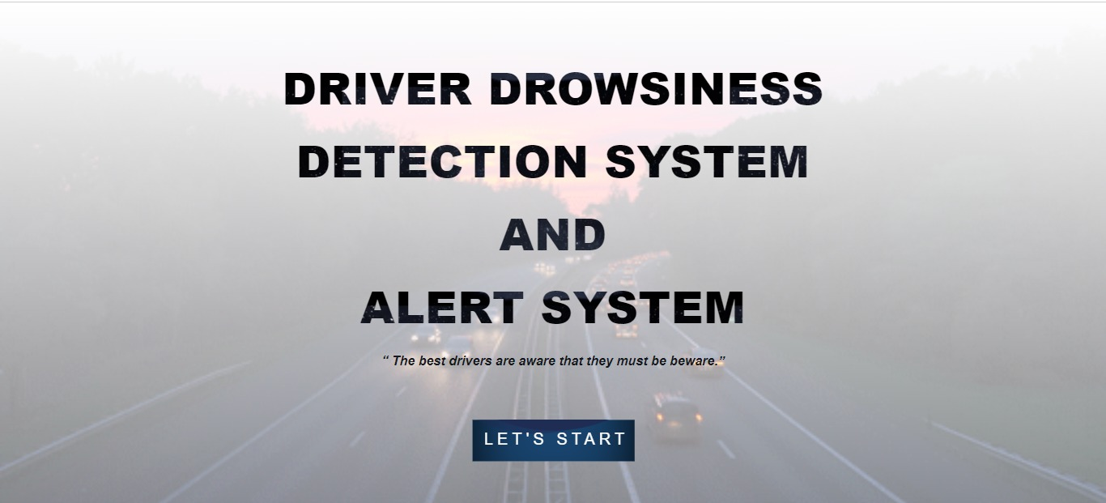
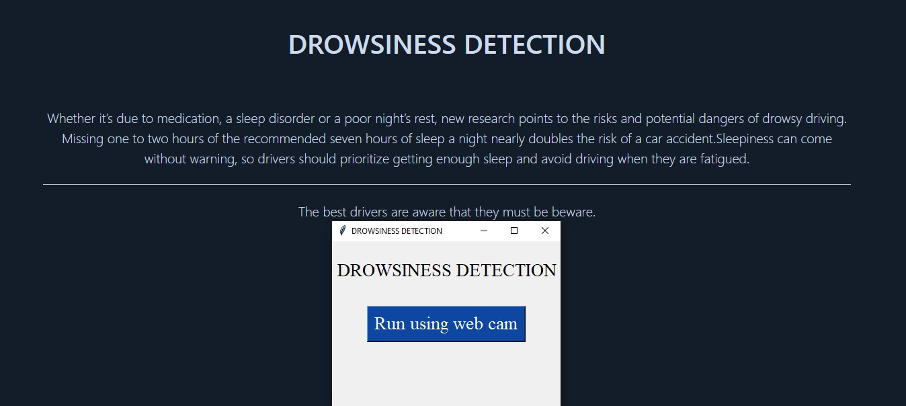
OUTPUT

Slide 19
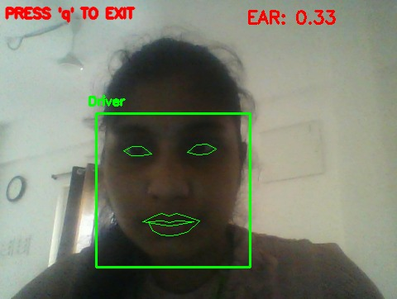
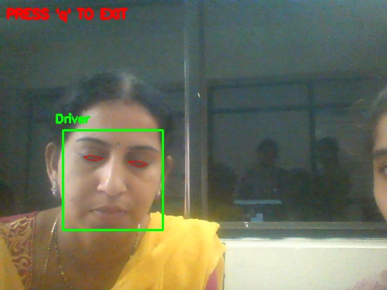
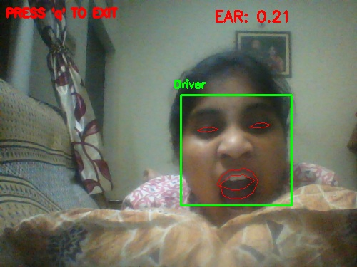
OUTPUT

Slide 20
CONCLUSION
A non-invasive system to localize the eyes and monitor fatigue was developed. Information about the eyes position is obtained through self-developed image processing algorithm. During the monitoring, the system is able to decide if the eyes are opened or closed. When the eyes have been closed for too long, a warning signal is issued.

Slide 21
FUTURE WORK
In the future,we will investigate the interaction of heart rate measurements,low mental workload during driving simulation and fatigue as well as perform numerical analysis of tractor accidents using a driving simulator

Slide 22
REFERENCES
[1] Rateb Jabbar, Khalifa Al-Khalifa, Mohamed Kharbeche, Wael Alhajyaseen, Mohsen Jafari, Shan Jiang “Real-time Driver Drowsiness Detection for Android Application Using Deep Neural Networks Techniques” proceedings for 9th international conference on Ambient Systems, Networks, and Technologies.
[2] Mohit Dua, Shakshi, Ritu Singla, Saumya Raj, Arti Jangra “Deep CNN models-based ensemble approach to driver drowsiness detection ” Neural Computing and Applications 33, 3155–3168 (2021).
[3] Mkhuseli Ngxande, Jules-Raymond, Michael Burke “Driver drowsiness detection using Behavioral measures and machine learning techniques: A review of state-of-art techniques” Pattern Recognition Association of South Africa and Robotics and Mechatronics International Conference (PRASA-RobMech)

Slide 23
THANK YOU

